Slide 1
Proposal Defense on Code Connect: Connect with Creatives
BCA : Project I
Faculty of Humanities and Social Sciences,TU
Name | Roll no:
Amit Maharjan | LEC077BCA01
Sushant Bramhacharya | LEC077BCA08
Date : 2023/06/3
Bishika Subedi
Project Coordinator
Department of Computer
Lalitpur Engineering College
Chakupat, Lalitpur

Slide 2
Introduction
What is Code Connect?

Slide 3
Motivation
Exposure for Newcomers
Community Building
Knowledge Sharing and Learning
Personal Growth and Challenge

Slide 4
Background
The project was conceptualized based on personal experiences.
Through discussions and research, it became evident that existing social media platforms lack on our needs.
The project aims to address this gap by creating a dedicated space for IT enthusiast.

Slide 5
Problem Statement
Lack of specific social media for IT enthusiast
Limited Facilities for sharing Resume and Projects
Limited Exposure in other social media
Specially for new aspiring developers and designers

Slide 6
Objectives
Develop a user-friendly social media web app specifically tailored to IT enthusiast.

Slide 7
Scope
Discussion/ Collaboration
Messaging
Showcase
Connection

Slide 8
Applications
Useful for new programmers, designers or other in IT.
Social Networking among IT enthusiast .
Discussion
Achievement Sharing

Slide 9
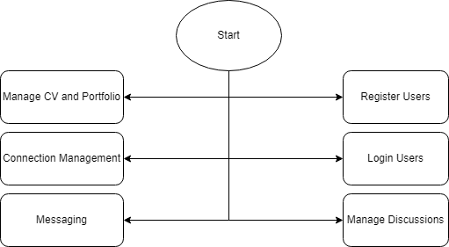
System Design (Architecture)

Slide 10
Literature Review
Social networks are like groups of people who know each other and interact with each other.[1]
LinkedIn is the preferred social media platform for recruiters, while Twitter and Facebook are less.[2]
Complete profiles in Stack Overflow lead to better quality posts.[3]

Slide 11
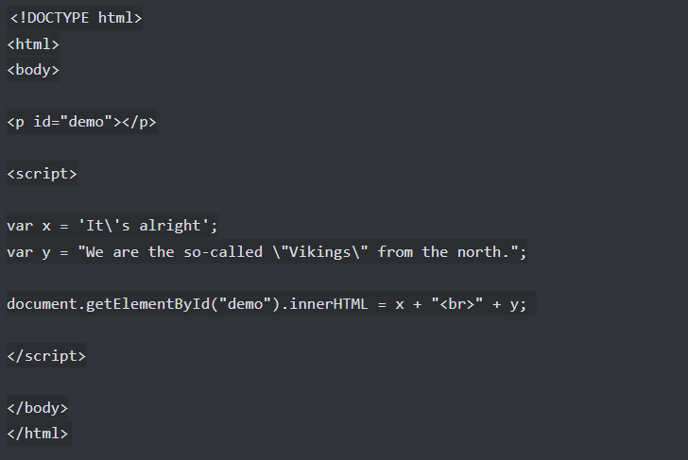
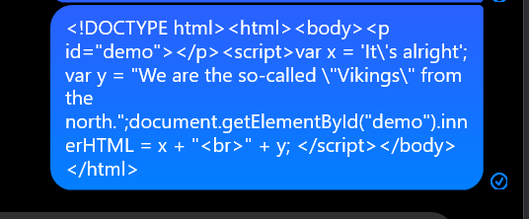
Real World problem
Messenger Proposed system

Slide 12
Contd..
Higher Reputation means Higher Exposure.[4]
GitHub Discussions faces challenges due to topic duplication with Issues, leading to confusion and redundancy.[5]

Slide 13
Proposed Methodology
Feasibility Study
Economic Feasibility
Technical Feasibility
Operational Feasibility

Slide 14
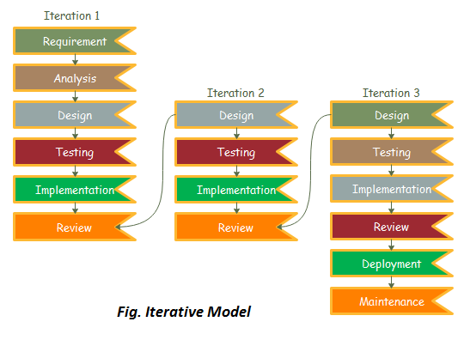
Iterative Model

Slide 15
Functional Requirements
User Registration/Login
User Profile Management
Connection Management
Discussion/News Feed
Messaging
Notifications

Slide 16
Non Functional Requirements
Performance
Authentication Security
Better UX design
Responsive Site

Slide 17
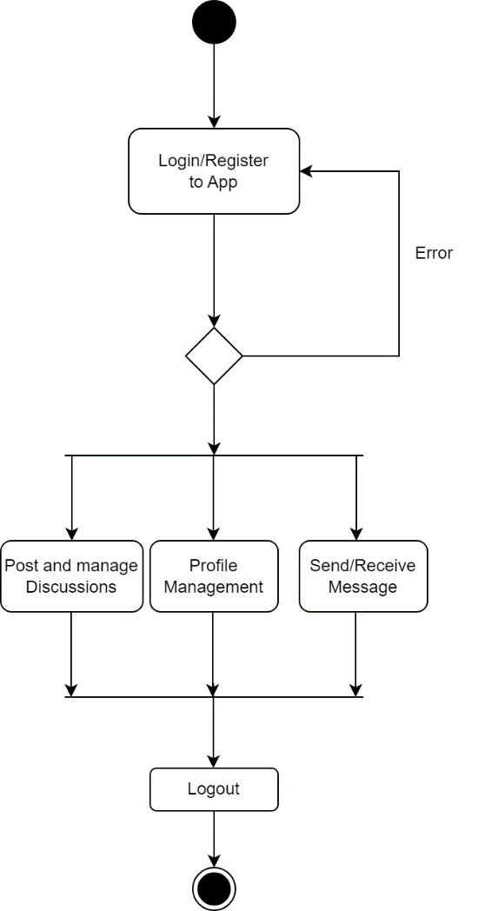
System Design (Activity Diagram)

Slide 18
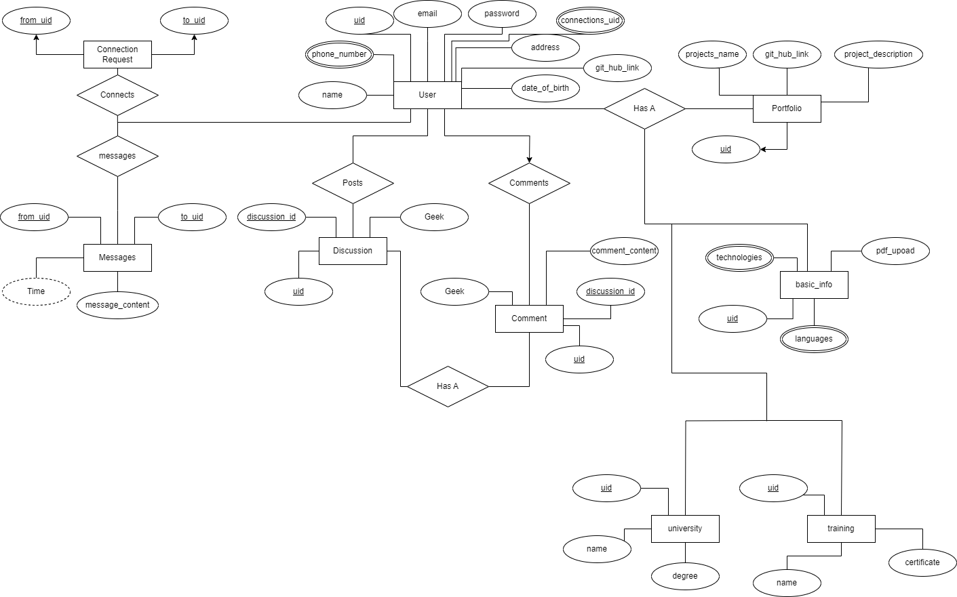
ER Diagram

Slide 19
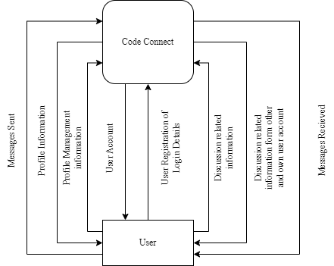
DFD Context Level

Slide 20

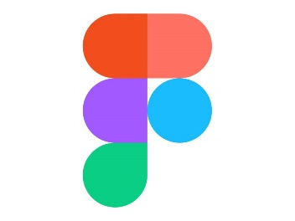



Tools Used
VCS : Git
Design : Figma
Repository Management : GitHub
Frontend : HTML, CSS, JS and React Js
Database : MySQL
Backend : PHP

Slide 21
Expected Results
The platform’s expected outcome is to create a vibrant and supportive ecosystem that empowers creative it professionals and enriches their professional lives

Slide 22
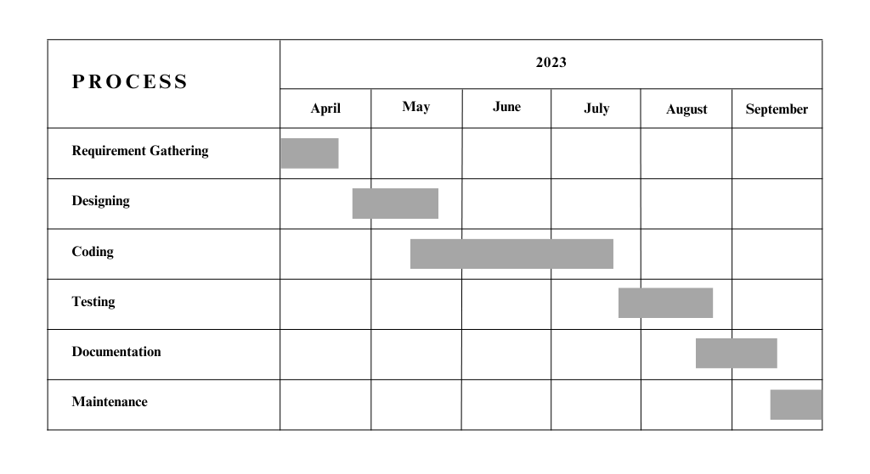
Timeline

Slide 23
References
[1] Anton Korshunov, Ivan Beloborodov, Nazar Buzun, Valeriy Avanesov, Roman Pastukhov, Kyrylo Chykhradze, Ilya Kozlov, Andrey Gomzin, Ivan Andrianov, Andrey Sysoev, et al. Social network analysis: methods and applications. Proceedings of the Institute for System Programming of the RAS (Proceedings of ISP RAS), 26(1):439–456, 2014.
[2] Tanja Koch, Charlene Gerber, and Jeremias J De Klerk. The impact of social media on recruitment: Are you linkedin? SA Journal of Human Resource Management, 16(1):1–14, 2018.
[3] Ifeoma Adaji and Julita Vassileva. Towards understanding user participation in stack overflow using profile data. In Social Informatics: 8th International Conference, SocInfo 2016, Bellevue, WA, USA, November 11-14, 2016, Proceedings, Part II 8, pages 3–13. Springer, 2016.
[4] Dorota Celinska. Coding together in a social network: collaboration among ´ github users. In Proceedings of the 9th international conference on social media and society, pages 31–40, 2018.
[5] Hideaki Hata, Nicole Novielli, Sebastian Baltes, Raula Gaikovina Kula, and Christoph Treude. Github discussions: An exploratory study of early adoption. Empirical Software Engineering, 27:1–32, 2022.

Slide 24
Q/A Session

Slide 25
THANK YOU ALL!!!

